Slide 1


SAP S/4HANA Training
MASTER DATA GOVERNANCE (SAP MDG)
Neeraj Gupta
Session 19
SAP MDG – Key and Value Mapping

Slide 2
Key mapping
19
SAP MDG – Key and Value Mapping

Slide 3
Key Mapping (Including ALE Audit) Define Technical Settings for Business Systems
19
SAP MDG – Key and Value Mapping
“Harmonized IDs”: Key mapping not considered
“Key Mapping” and (“Update KM via ALE audit” unchecked or BD10 outbound)
>> Key mapping needed for material >> DRF/ALE outbound fails if key mapping is missing
DRF only: “Key Mapping” and “Update KM” (via ALE audit) checked
>> Key mapping considered if available
>> If not available, the hub sends its material number
>> Client can Either accept it and confirm via ALE audit
>> Or provide new, internally assigned material number and send it back to MDG Hub via ALE Audit and the key mapping gets updated on Hub

Slide 4
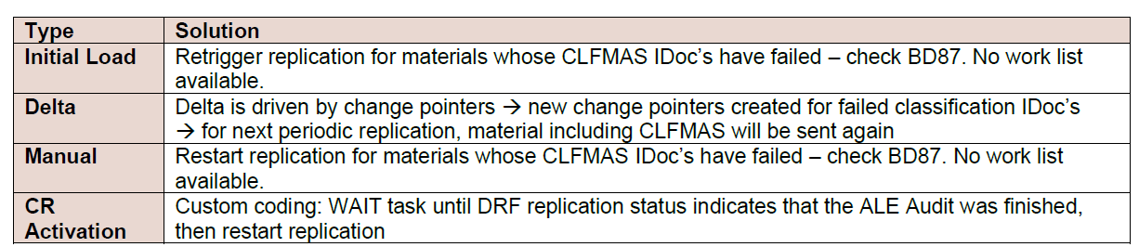
ALE auditing Configure client and hub systems so that the client systems send confirmation of replicated materials back to the MDG hub SAP Ref. Link >> The customizing for ALE audit is described in the section Customizing for ALE Audit (Optional) in Adapting Master Data Governance for Material → Key Mapping https://help.sap.com/viewer/db97296fe85d45f9b846e8cd2a580fbd/MDG92.latest/en-US
19
SAP MDG – Key and Value Mapping
ALE Audit with Classification IDoc’s
CLFMAS IDoc’s must not be sent until ALE audit has returned the material number of the target system and updated the key mapping
Solution: Prerequisite is SAP Note 2030807

Slide 5
19
SAP MDG – Key and Value Mapping
Value Mapping
Map the internal code values to the code values of a given external list
Default set of fields relevant for IDoc value mapping
>> Corresponding maintenance view MDG_MAT_VALMAP_V

Slide 6
19
SAP MDG – Key and Value Mapping
Value Mapping
Use case:
E.g. IDoc contains the ISO representation of e.g., Unit of Measurements, Language Codes and Country Codes, the MDG value mapping uses the internal representation
Example: Unit “Cubic Centimeters” has internally the code CCM, the corresponding ISO code is CMQ. Without value mapping, the IDoc sends CMQ, whereas the value mapping needs to map CCM instead of CMQ. Prerequisite is SAP Note 2036316
Enable value mapping >> Assign the code list for the data element in the MDG hub configuration

Slide 7
19
SAP MDG – Key and Value Mapping
Value Mapping
Correct data type for field MARA-MTART (Material Type) is MDG_BS_MATERIAL_TYPE_CODE. For field MARC-MMSTA (Plant-Specific Material Status) it is “MDGCO_PROD_LOG_PROCUSABPR_CODE

Slide 8
File Import Export
20
SAP MDG – Data Import / Export
Use case: Mass maintenance of value mapping (customizing mapping) via File Export/ Import. Value mapping is an alternative to synchronizing the customizing entries.
Solution: WebDynpro applications Master Data and Customizing File Export (MDG_EXTR_FPM_CMP) and Master Data File Import (MDG_FILE_UPLOAD_CMP) are used to export the current value mapping, enrich the mapping and import it into the system.
Define a value mapping
Navigate to General Settings > Value Mapping > Maintain Value Mapping

Slide 9

End of Session19

Slide 10

Questions

Slide 11

Neeraj gupta

Slide 12


We’re committed to empower you to be
Most Desirable Resource
through powerful training solutions.
We build the workforce of the future.
250+
Corporate Clients
30,000+
Learners Trained
25000+
Learners Placed
FREE WEBINARS
Sign up for free webinars with industry experts every fortnight!
Enroll Now!
Contact us today!
https://anubhavtrainings.com/

Slide 13




More from AnubhavTrainings.com

